Slide 1
Ideate and implement a system to enhance the quality of education in rural areas.
CSE7101- Capstone Project
Review-2
Batch Number: COM_21
Under the Supervision of,
Mr..Sunil Kumar Sahoo
Assistant Professor
School of Computer Science and Engineering
Presidency University
20221COM0019 | Makandar Saba Fareen
20221COM0052 | Pikkili Sai Tarishma
20221COM0039 | Billa SunilKumar
Roll Number | Student Name
Name of the Program: COM
Name of the HoD: Dr. Pallavi R
Name of the Program Project Coordinator: Ms. Benitha Christinal J
Name of the School Project Coordinators: Dr. Sampath A K , Dr. Geetha A

Slide 2
Content
Abstract
Problem Statement
Objectives
Literature Survey
Existing Methods and Drawbacks
Proposed Methodology
Architecture Diagram
Modules
Implementation Progress

Slide 3
Content
Hardware & Software Requirements
Timeline (Gantt Chart)
Innovation / Novel Contributions
SDG Mapping
References

Slide 4
Abstract
Design and development of a Trial App for students
Provides quizzes for self-assessment
Enables access to personalized content anytime
Tracks student performance and progress
Aims to create a user-friendly, engaging, and efficient platform
Supports continuous learning and academic growth

Slide 5
Problem Statement
Many students struggle to assess their knowledge effectively outside the classroom.
Existing learning platforms often lack personalized content tailored to individual needs.
Students face difficulty in tracking their progress and identifying areas for improvement.
There is a need for a simple, engaging, and accessible digital tool that combines quizzes with personalized learning resources.

Slide 6
Objectives
To design and develop a Trial App for students
To provide interactive quizzes for self-assessment
To enable access to personalized content anytime, anywhere
To help students track their progress and improve performance
To create a user-friendly and engaging learning experience
To support continuous learning and academic growth

Slide 7
Literature Survey
Key Learnings:
Studies show mobile learning and quiz-based tools improve engagement and learning gains.
Formative quizzes can predict and improve summative exam performance — they support retention and identify weak areas.
Adaptive / personalized learning systems (AI-driven) increase effectiveness by tailoring content and difficulty to the learner.
Learning analytics provide actionable insights (progress tracking, mastery indicators) and improve assessment design.

Slide 8
Literature Survey
Recent work on real-time adaptive quiz platforms reports higher engagement and
improved outcomes when feedback is immediate and differentiated.
Gaps: many studies are domain-specific or lab-based; there is limited research on
integrated mobile quiz apps that combine adaptive algorithms, personalized content
delivery, and robust analytics in real classroom deployments.

Slide 9
Existing Methods & Drawbacks
Lack of personalized learning content for individual needs.
Low student engagement due to limited interactivity.
Inadequate tracking of student progress and performance.
Disconnection between quizzes and learning resources.
Delayed or absent feedback after assessments.

Slide 10
Proposed Methodology
Pipeline:
Requirement Analysis:Gather student needs and define app features through surveys and interviews.
System Design:Create wireframes, architecture diagrams, and data flow models for the Trial App.
Development:Build the app with quiz functionality, personalized content delivery, and a progress tracker.
Integration of Features:Implement adaptive learning algorithms, instant feedback mechanisms, and analytics dashboards
Testing & Feedback:Perform usability testing with target students and iterate based on feedback.
Deployment & Maintenance:Deploy on mobile platforms and continuously update based on usage analytics and user feedback

Slide 11
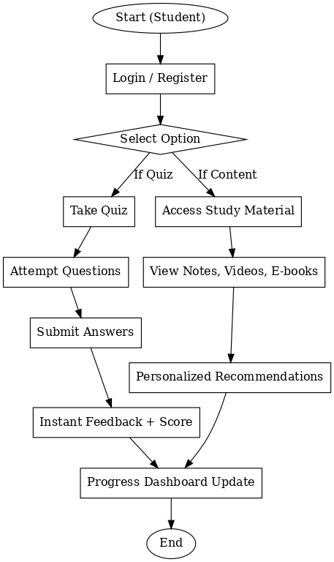
Architecture Diagram

Slide 12
Modules
User Authentication Module – Handles student registration, login, and secure access.
Quiz Management Module – Provides quizzes, randomizes questions, collects responses, and generates instant feedback.
Content Delivery Module – Gives access to notes, e-books, and video lectures with personalized recommendations.
Performance Tracking Module – Maintains progress dashboards, shows scores, and highlights weak areas.
Analytics & Recommendation Module – Analyzes quiz results and learning patterns to suggest personalized content.

Slide 13
Implementation Progress
Completed so far:
Study material repository created with notes and video lectures uploaded.
Quiz module developed – students can attend quizzes and submit responses.
Score tracking feature integrated – students can check results after quizzes.
In Progress:
Personalized content delivery based on quiz performance.
Dashboard enhancement for detailed progress monitoring and weak-area analysis.
Planned:
Upload additional videos to expand the content library.
Add more quiz questions for wider practice coverage

Slide 14
Hardware & Software Requirements
Software:
Development Environment: Android Studio
Programming Languages: Java / Kotlin
Database & Backend: Firebase (Authentication, Firestore, Realtime Database, Cloud Storage)
Version Control: GitHub
Operating System (for development): Windows 10 / Linux / macOS
Emulators & SDKs: Android SDK, AVD for app testing

Slide 15
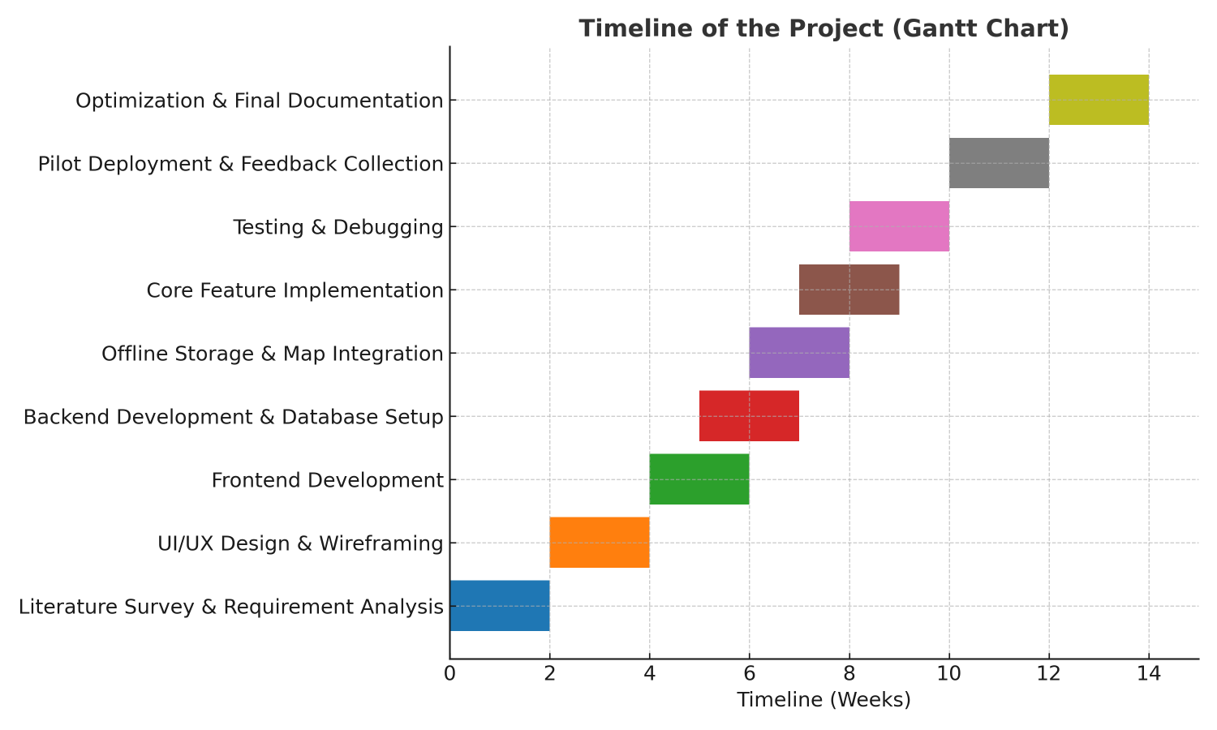
Timeline (Gantt Chart)

Slide 16
Innovation / Novel Contributions
Combines study material (videos, notes) and quizzes in a single mobile app.
Students can check quiz scores immediately and monitor progress in real time.
Adaptive content recommendations based on quiz performance.
Visual insights into strengths, weak areas, and overall academic growth.
Uses Firebase for secure authentication, data storage, and easy scalability.
Ensures accessibility even with limited or no internet connectivity.
SDG Mapping
SDG 4 – Quality Education
SDG 8 – Decent Work and Economic Growth

Slide 17
References (in IEEE format)
[1] A. Sortwell, K. Trimble, R. Ferraz, et al., “A systematic review of meta-analyses on the impact of formative assessment on K-12 students’ learning,” Sustainability, vol. 16, no. 3, pp. 1–24, 2024.
[2] N. Zhang, “Can formative quizzes predict or improve summative exam performance?,” Perspectives on Medical Education, vol. 4, no. 6, pp. 358–364, 2015.
[3] Q. Xuan, “The effectiveness of formative assessment for enhancing learning in higher education: A systematic review,” Frontiers in Psychology, vol. 13, pp. 1–12, 2022.
[4] R. Krishnan, “Smart analysis of learners’ performance using learning analytics,” Education Sciences, vol. 12, no. 8, pp. 1–18, 2022.

Slide 18
References (in IEEE format)
[5] K. I. Vorobyeva, A. S. Kiryakova, and A. S. Kolesnikov, “Personalized learning through AI: Pedagogical approaches and critical insights,” Contemporary Educational Technology, vol. 17, no. 2, pp. 1–15, 2025.
[6] “Exploring the impact of adaptive real-time quiz platforms on learning performance,” International Journal of Information and Education Technology, vol. 15, no. 3, pp. 221–229, 2025.

Slide 19


